Slide 1

BD9C601EFJEVK-101 Measurement Report
April 16th, 2014
Hosted by: Xuan Dang

Slide 2
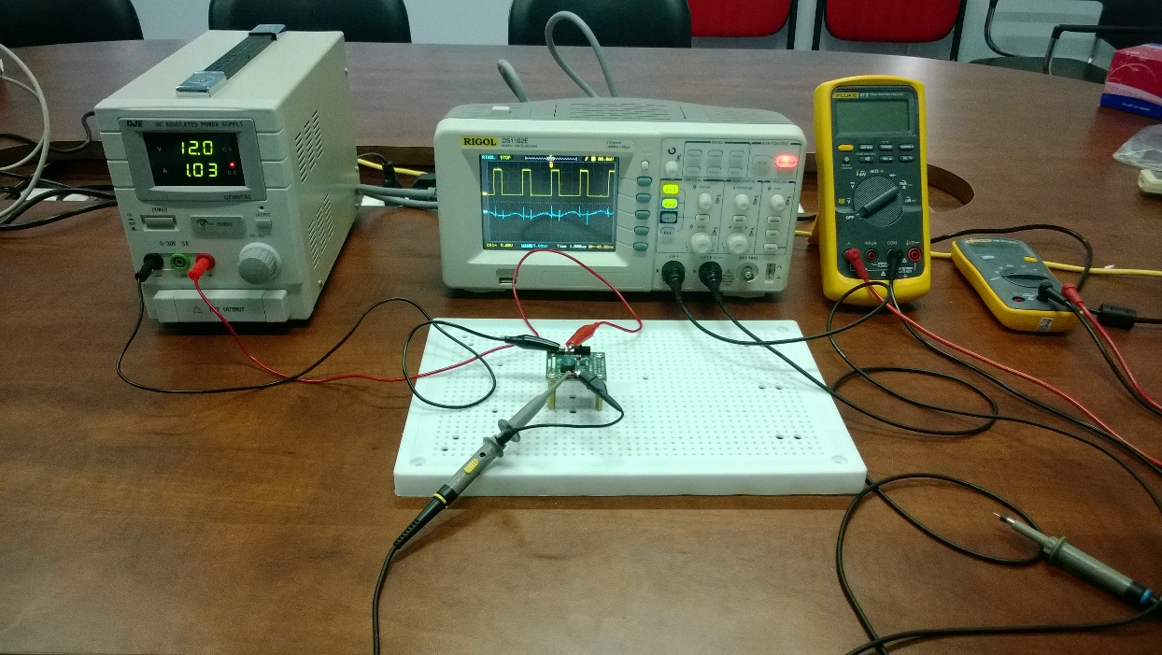
Equipment list
Regulated DC Power Supply
QJE QJ3005XE (0-30V/5A)
Multimeter:
Fluke 87V True RMS
Fluke 106
Oscilloscope
Rigol DS1102E
Electronic Load
B&K BK8500
Current probe
RP1001C

Slide 3
Functional Test
Testing procedure
Turn on the DC Supply. Set output of the DC Supply in range from 4.5V to 18V and turn it off. Connect DC the Supply to: [+]V_{IN}(TP1) and [-]GND(TP2) of evaluation board.
Connect Electronic Load to: [+]V_{OUT}(TP3) and [-]GND(TP4). Power on Electronic Load, set input of Electronic Load to 6A.
Turn on the DC Supply.
Turn on load.
Move J1 header to turn EN on.
Result:
V_{IN} = 4.5V to 18V
V_{OUT} = 3.22V ~ 3.29V.
Test passed.

Slide 4
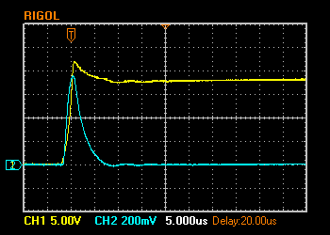
Hot Plugging Test
Test condition
V_{IN} = 18V
I_{OUT} = 6A
With original diode D2: SMAJ15A
Result:
I_{IN MAX}= 76A
V_{IN} peak transient voltage is 22V > V_{IN} Maximum Rating (20V)
I_{CC} quiescent current is 93mA at V_{IN}=18V
The IC still operate properly after 100+ test time.
V_{IN} 5V/Div. (DC)
I_{IN} 20A/Div. (AC)

Slide 5
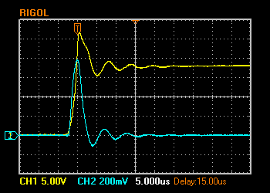
Hot Plugging Test (cont.)
Test condition
V_{IN} = 18V
I_{OUT} = 6A
With diode D2: SMAJ18A
Result:
I_{IN MAX}= 78.4A
V_{IN} peak transient voltage is 26.8V > V_{IN} Maximum Rating (20V)
I_{CC} quiescent current is 29mA at V_{IN}=18V
The IC still operate properly after 100+ test time.
V_{IN} 5V/Div. (DC)
I_{IN} 20A/Div. (AC)

Slide 6
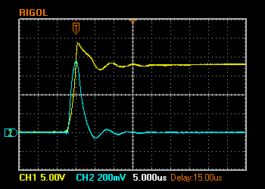
Hot Plugging Test (cont.)
Test condition
V_{IN} = 18V
I_{OUT} = 6A
With diode D2: SMAJ16A
Result:
I_{IN MAX}= 75.2A
V_{IN} peak transient voltage is 23.8V > V_{IN} Maximum Rating (20V)
I_{CC} quiescent current is 26mA at V_{IN}=18V
The IC still operate properly after 100+ test time.
V_{IN} 5V/Div. (DC)
I_{IN} 20A/Div. (AC)

Slide 7
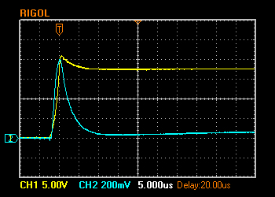
Hot Plugging Test (cont.)
Test condition
V_{IN} = 18V
I_{OUT} = 6A
With diode D2: SMAJ14A
Result:
I_{IN MAX}= 80A
V_{IN} peak transient voltage is 21V > V_{IN} Maximum Rating (20V)
I_{CC} quiescent current is 200mA at V_{IN}=18V
V_{IN} 5V/Div. (DC)
I_{IN} 20A/Div. (AC)

Slide 8
Hot Plugging Test (cont.)
Test condition
V_{IN} = 18V
I_{OUT} = 6A
With diode D2: SMAJ13A
Result:
I_{IN MAX}= 82.4A
V_{IN} peak transient voltage is 18.8V < V_{IN} Maximum Rating (20V)
I_{CC} quiescent is 380mA at V_{IN}=18V
V_{IN} 5V/Div. (DC)
I_{IN} 20A/Div. (AC)

Slide 9
Circuit Quiescent Current Measurement
Test condition
V_{IN} = 0-18V
Room temperature 25ºC

Slide 10
Efficiency Measurements
Test condition
V_{IN} = 12V
V_{OUT} = 3.3V
With SMAJ15A
Room temperature 25ºC

Slide 11
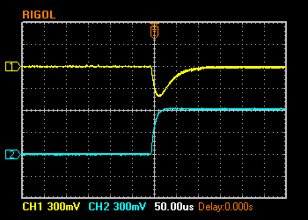
Load Response Measurements
Load response characteristic
(V_{IN}=12V, V_{OUT}=3.3V, I_{OUT}=0 → 6A)
V_{OUT} 300mV/Div. (AC)
I_{OUT} 3A/Div. (DC)

Slide 12
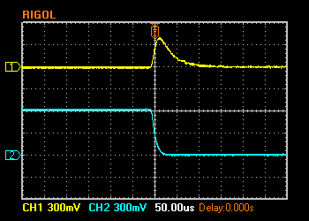
Load Response Measurements (cont.)
Load response characteristic
(V_{IN}=12V, V_{OUT}=3.3V, I_{OUT}=6A → 0)
V_{OUT} 300mV/Div. (AC)
I_{OUT} 3A/Div. (DC)

Slide 13
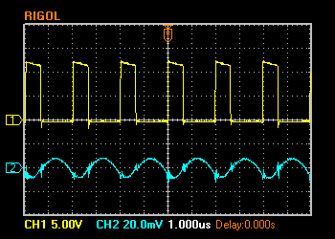
Ripple Response Measurements
V_{OUT} Ripple voltage
(V_{IN}=12V, V_{OUT}=3.3V, I_{OUT}=6A)
V_{SW} 5V/Div. (DC)
V_{OUT} 20mV/Div. (AC)

Slide 14
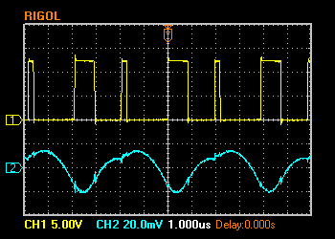
Ripple Response Measurements (cont.)
V_{OUT} Ripple voltage
(V_{IN}=12V, V_{OUT}=3.3V, I_{OUT}=0A)
V_{SW} 5V/Div. (DC)
V_{OUT} 20mV/Div. (AC)

Slide 15
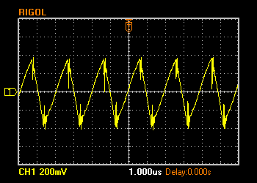
Input Voltage Ripple Measurements
V_{IN} Ripple voltage
(V_{IN}=12V, V_{OUT}=3.3V, C_{IN}=10uF+ 0.1uF, I_{OUT}=6A)
V_{IN} 200mV/Div. (AC)

Slide 16
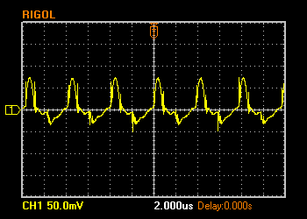
Input Voltage Ripple Measurements (cont.)
V_{IN} Ripple voltage
(V_{IN}=12V, V_{OUT}=3.3V, C_{IN}=10uF + 0.1uF, I_{OUT}=0A)
V_{IN} 50mV/Div. (AC)

